Slide 1

Building the Enlightened Enterprise
JBoss BPM Suite BAM Dashboard
Eric D. Schabell
JBoss Tech Evangelist (Integration & BPM)
TITLE SLIDE: HEADLINE
Presenter name
Title, Red Hat
Date

Slide 2
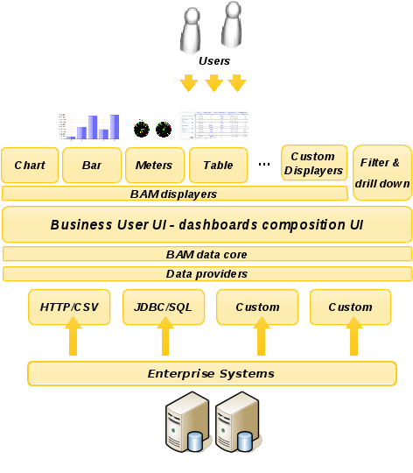

Architecture overview
Available at:
https://github.com/eschabell/bpms-bam-dashboard
Detailed instructions about how to run.

Slide 3
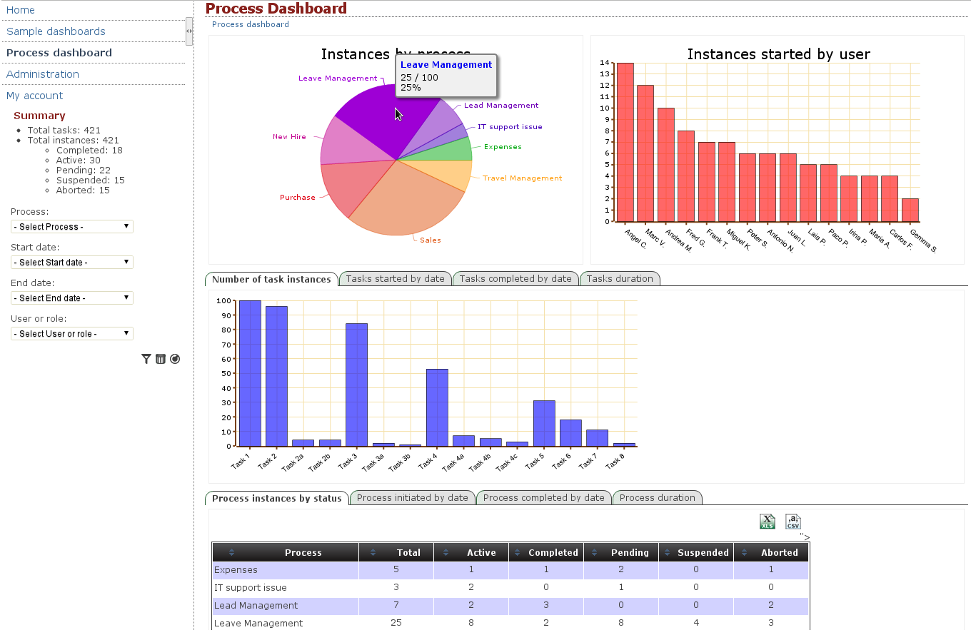
jBPM Process dashboard

Slide 4
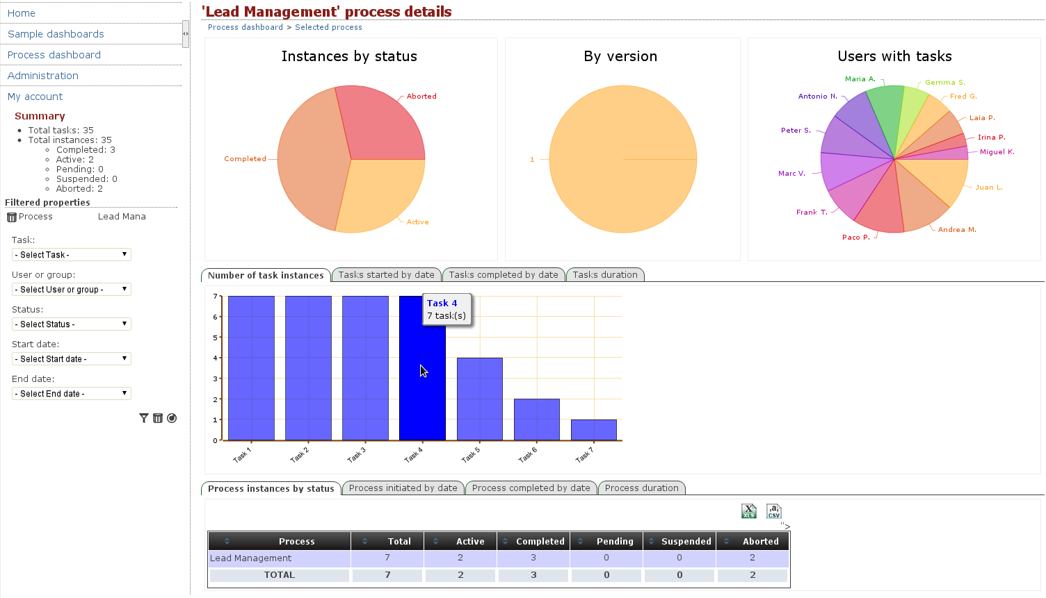
jBPM Process dashboard – selected process

